Slide 1
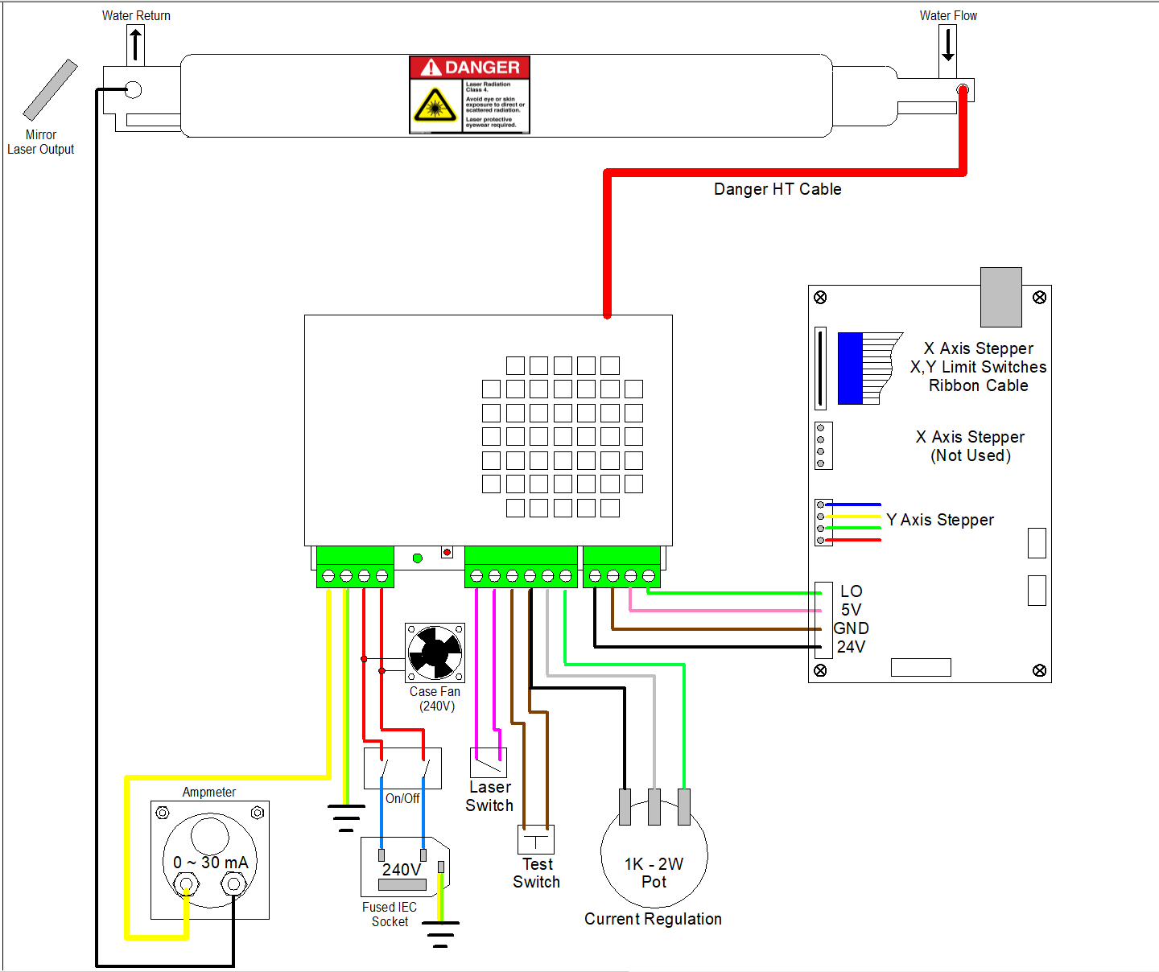
K40 Wiring
david@securityt.com
Use this information at your own risk

